Slide 1
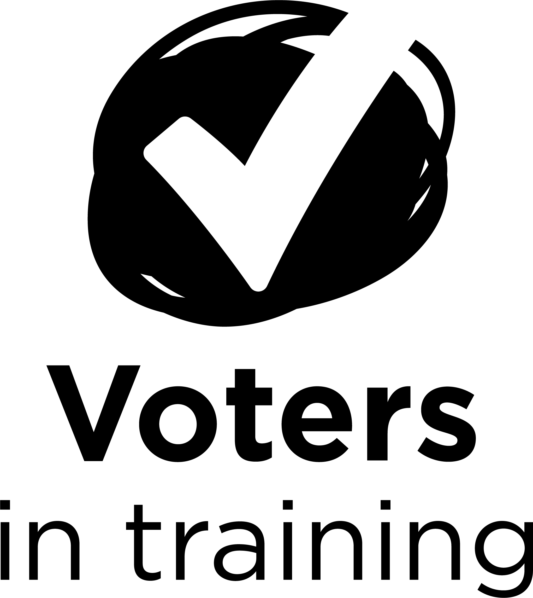
Federal, provincial and municipal:
Which level of government does what?
Preparing to vote
Notes:
Suggested animation
In this activity, you will discover how the government and its decisions affect day-to-day life.
Additional information taken from the Federal, provincial and municipal: Which level of government does what? activity sheet
This activity teaches voters in training about the different levels of government (federal, provincial and municipal) and their respective jurisdictions. They will also be encouraged to continue reflecting on matters pertaining to the current election.
Objectives:
Identify the jurisdictions belonging to the different levels of government
Reflect on matters pertaining to the current election

Slide 2
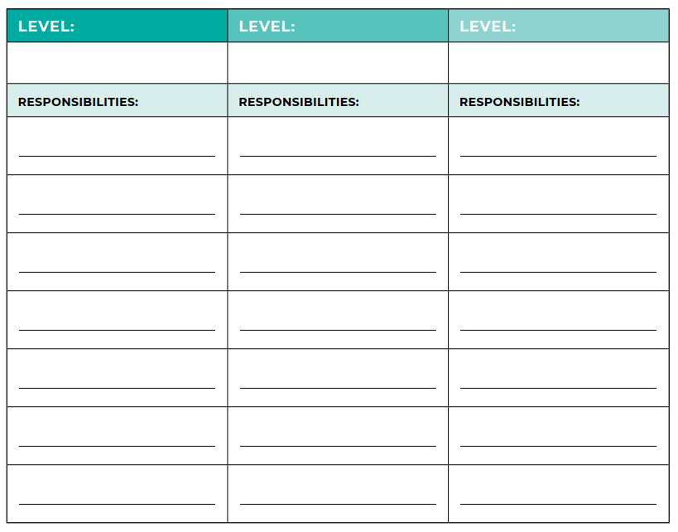
The three levels of government
Notes:
Suggested animation
Hand out The three levels of government activity sheet to each student.
Tell the students that they will be watching a video about the levels of government and their responsibilities. They should pay attention to the examples of responsibilities given in the video, as they will need to note these on their sheet, in the column corresponding to the right level of government (municipal, provincial, or federal).
Ask if they have any questions and answer as needed.

Slide 3
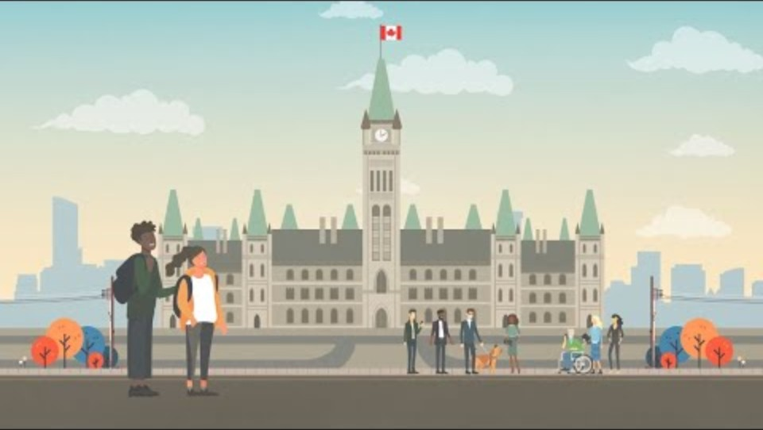

Notes:
Suggested animation
Start the Three Levels of Government video (click on the video embedded in the slide).

Slide 4
The three levels of government
FEDERAL
PROVINCIAL or TERRITORIAL
MUNICIPAL
Cell phone services
Schools
Recycling
Road test or driver’s
licence
Telecommunications
Parks
Canada Post
Rules of the road
Community centres
Money
Courts
Recreational facilities
Passports
Health
Public transit
Armed Forces and Royal Canadian Mounted
Police (RCMP)
Education
Drinking water
Security or police
Notes:
Suggested animation
Return to the larger group and correct The three levels of government activity sheet.
(CLICK)
The three levels of government appear
(CLICK)
The responsibilities mentioned at the federal level appear
(CLICK)
The responsibilities mentioned at the provincial level appear
(CLICK)
The responsibilities mentioned at the municipal level appear

Slide 5
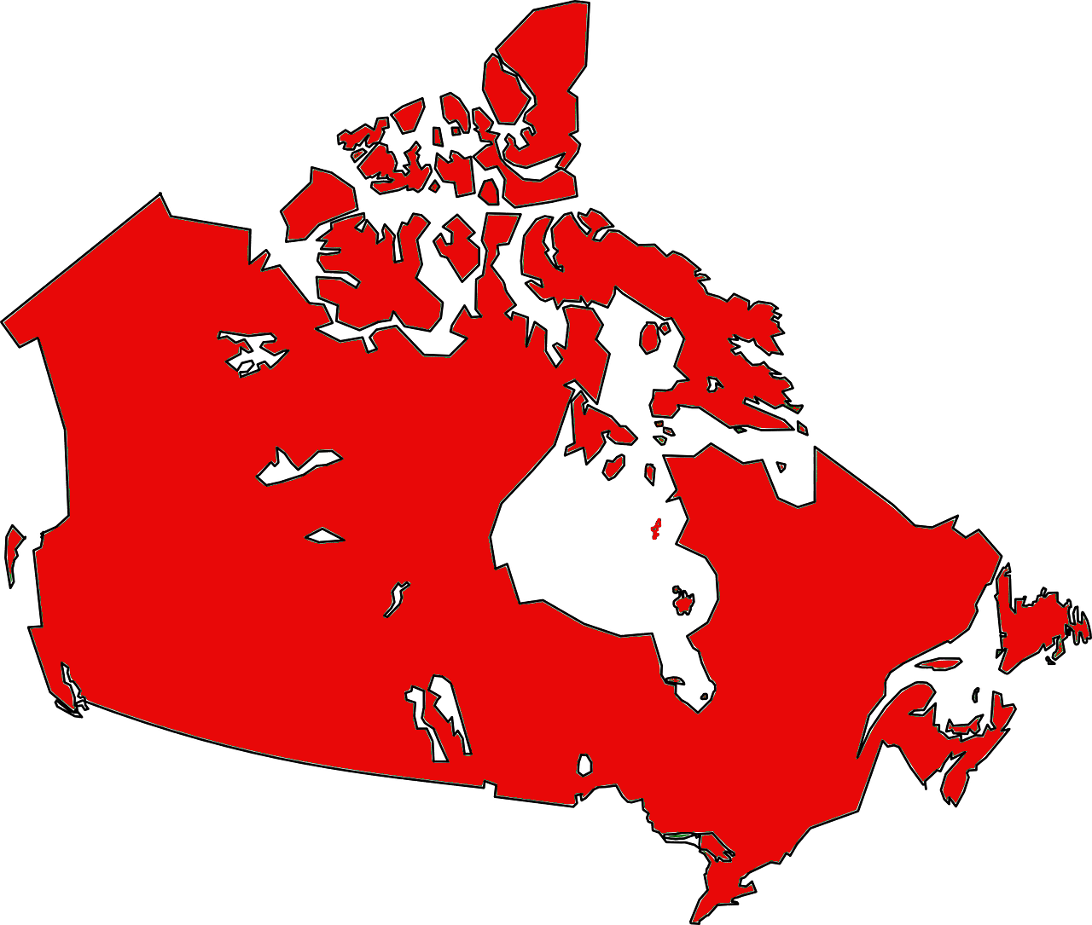



Notes:
Suggested animation
Canada is a large country, made up of territories and provinces.
(CLICK)
For example, there is Québec.
(CLICK)
And municipalities.
Needs differ from one province and one municipality to the next.
For example, public transit needs in a city (where people live close together) are not the same as in the country (where people live far apart).
Every municipality is responsible for its own public transit because of this difference in needs.
That’s why there are different levels of government.

Slide 6

Notes:
Suggested animation
And here I draw your attention.

Slide 7
Government levels
Jurisdiction = responsibility
Notes:
Suggested animation
When we talk about levels of government, we use the word jurisdiction, which means the same thing as responsibility.

Slide 8

When you work in a team…
Who decides?
Who does what?
Notes:
Suggested animation
Sometimes you work on projects alone. Do you ever work on a project in a team, with other students?
Give me an example of a project you could work on with other students.
(Take a few answers)
In a team project, is it always the same person who decides, or do you make decisions together?
(Expected answer: we decide together)
Does the same person do everything, or do you share responsibilities within the team?
(Expected answer: we share responsibilities)
Our government is like a work team.
Sometimes, tasks and responsibilities are divided among different levels of government.
Each level has a role and specific jurisdictions. These are known as shared jurisdictions.

Slide 9

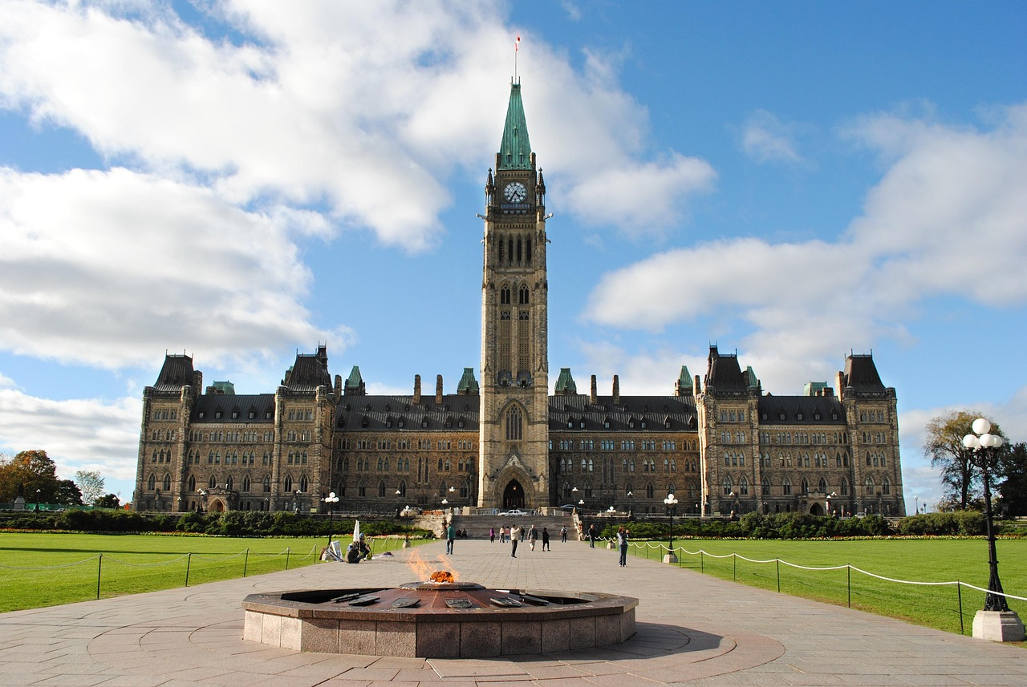
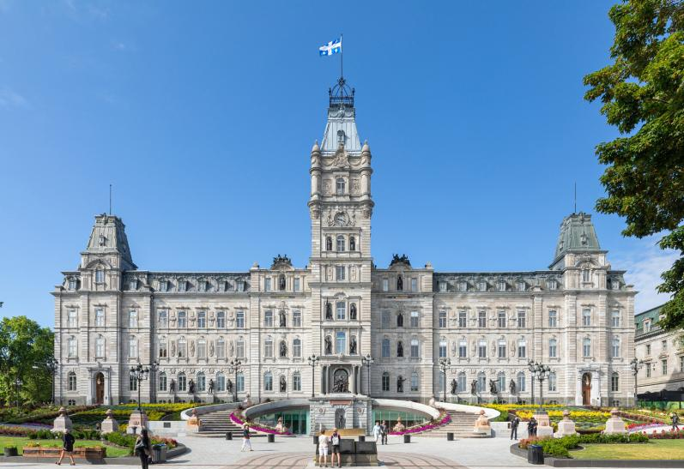
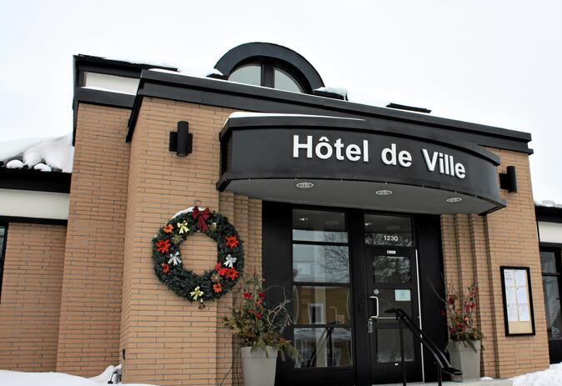
Government levels
FEDERAL
PROVINCIAL
MUNICIPAL
Notes:
Suggested animation
Note: The flag of Québec City was used to illustrate the municipal level, but you can replace it with your municipality’s flag.
There are three levels of government:
federal, which sits in the Parliament of Canada, in Ottawa;
provincial, which sits at the Assemblée nationale du Québec, in Québec City;
municipal, which sits in the town hall of every city, town, and village. Do you know where your municipality’s town hall is?
(If possible, indicate the location of the town hall in the municipality where the school or organization is located)
The federal level of government handles everything that affects all Canadians. I’ll give you a few examples: the army, the money you use, and the Internet, which lets you communicate with your friends.
The provincial level of government handles everything that affects a province or territory. You live in the province of Québec. For example, the Gouvernement du Québec takes care of hospitals, transportation, and your school.
The municipal level of government handles everything having to do with a city, a town, or a village. Maybe you didn’t know it, but this closely affects you. You probably use its services every day:
when you go play in the park
when you take out the trash
when you get water from the tap
You see, it’s often the municipal level that makes the decisions that affect us directly.
Additional information taken from the Federal, provincial and municipal: Which level of government does what? activity sheet
Our political system is made up of three levels of government that share powers or jurisdictions: federal, provincial, and municipal. When it comes time to vote, it’s important to know the jurisdictions of each level of government, so you know which jurisdictions the elected person will be responsible for.
Federal and provincial jurisdictions
The Canadian Constitution defines the division of powers between the province of Québec and the federal government.
Some jurisdictions are exclusive, but others are shared between the federal and provincial governments.
Examples of federal jurisdictions:
National defence (Armed Forces, Royal Canadian Mounted Police)
Postal services
Money and banking
Indigenous affairs
Foreign affairs and trade
Criminal law
Employment insurance
Citizenship
Passports
Air, marine, and rail transportation
Telecommunications and broadcasting
Examples of provincial jurisdictions:
Education
Hospitals and health care
Administration of justice
Civil law
Vehicle registration and driver’s licence
Recreational or sport fishing licences
Labour (employment standards, health and safety)
Birth certificates
Lotteries
Highway signage
Municipal jurisdictions
Municipal politics play an important role in our democracy. Elected officials at this level are responsible for issues that closely affect the community.
Québec municipalities hold elections every four years, on the first Sunday in November. These elections make it possible to choose the people who will represent the municipality’s residents.
Examples of municipal jurisdictions:
Urban planning and development
Public transit
Housing, including social housing
Assistance for the homeless
Social and community development
Municipal parks and recreation
Libraries
Public safety (police and fire services)
Residual materials management (garbage collection, as well as waste recycling and reuse)
Local roads (e.g. street maintenance and snow removal)
Water and sewer services

Slide 10
Government levels
FEDERAL
PROVINCIAL
MUNICIPAL
Notes:
Suggested animation
Note: The flag of Québec City was used to illustrate the municipal level, but you can replace it with your municipality’s flag.
If we go back to the division of jurisdictions between levels of government, we see that some jurisdictions are shared between the federal and provincial levels.
Here are some examples of shared federal-provincial jurisdictions:
Agriculture
Environment
Immigration
Jurisdictions can also be shared by the provincial and municipal levels.
Additional information taken from the Federal, provincial and municipal: Which level of government does what? activity sheet
Examples of shared jurisdictions (federal and provincial):
Agriculture
Immigration
Transportation
Culture
Environment

Slide 11



How do you know which level of government to contact?
Notes:
Suggested animation
Note: Québec City’s logo was used to illustrate the municipal level, but you can replace it with your municipality’s logo.
Some jurisdictions belong to a single level of government, but others are shared. In that case, how do you know which level of government to contact?
(CLICK)
You can ask yourself which population is affected by this jurisdiction.
Does it affect citizens across the entire country, the province, or only a municipality?
(CLICK)
You can look for a visual symbol representing the level of government responsible, such as a sign, a flag, or a logo.
(CLICK)
You can ask someone in your circle.
You can look online.
The government and the decisions it makes affect our daily lives.
You don’t need to look far to find examples!

Slide 12

Test you knowledge!
Notes:
Suggested animation
Split the students into groups of four and hand out the Federal, provincial and municipal: Which level of government does what? activity sheet to each team.
Introduce the activity:
Now that we know more about the levels of government and their jurisdictions, it’s time to take action.
In each scenario, put a check mark under the level of government to contact (federal, provincial, or municipal).
Take the time to think it through. We saw earlier that you can ask yourself which population the service is for: residents of the entire country, the province, or the municipality.
You can also discuss it amongst yourselves, since you’ve all had different experiences that could help you find the answer.
Ask if they have any questions and answer as needed.
Do the exercise by presenting the scenarios to the students.
Come back to the larger group and show the answers onscreen, giving any explanations needed.
Variant: You can carry out the activity as a large group, in quiz format, without handing out the Federal, provincial and municipal: Which level of government does what? activity sheet.

Slide 13

SCENARIO NO. 1
You just adopted a cat. He’s very adventurous. He tries to sneak outside every time the door opens.
You want to register your cat to avoid losing him. Which level of government should you contact?
Federal
Provincial
Municipal
Notes:
Suggested animation
Read the scenario and ask the students:
In your opinion, which level of government is responsible for this jurisdiction?
Take a few answers.

Slide 14
SCENARIO NO. 1
You just adopted a cat. He’s very adventurous. He tries to sneak outside every time the door opens.
You want to register your cat to avoid losing him. Which level of government should you contact?
Federal
Provincial
Municipal
Managing domestic animals is a jurisdiction shared
by the provincial and municipal levels of government.
Notes:
Suggested animation
In this situation, you need to contact your municipality, as it is responsible for registering domestic animals.
Managing these animals is a jurisdiction shared between the provincial and municipal levels, but municipalities play a major role.
The province is responsible for general care and safety regulations while municipalities are responsible for local regulations, called by-laws (leash requirements, animal registration, etc.).

Slide 15
SCENARIO NO. 2
It’s spring and you can’t wait to go fishing at the river.
But first you need a fishing licence. Which level of government
should you contact?
Federal
Provincial
Municipal
Notes:
Suggested animation
Read the scenario and ask the students:
In your opinion, which level of government is responsible for this jurisdiction?
Take a few answers.

Slide 16
SCENARIO NO. 2
It’s spring and you can’t wait to go fishing at the river.
But first you need a fishing licence. Which level of government
should you contact?
Federal
Provincial
Municipal
Notes:
Suggested animation
This is the provincial government’s responsibility.

Slide 17
SCENARIO NO. 3
Last year, the river overflowed and caused damage to your municipality. Soldiers came to help.
You’re wondering which level of government is responsible for the soldiers. Which level do you think it is?
Federal
Provincial
Municipal
Notes:
Suggested animation
Read the scenario and ask the students:
In your opinion, which level of government is responsible for this jurisdiction?
Take a few answers.

Slide 18
SCENARIO NO. 3
Last year, the river overflowed and caused damage to your municipality. Soldiers came to help.
You’re wondering which level of government is responsible for the soldiers. Which level do you think it is?
Federal
Provincial
Municipal
Notes:
Suggested animation
This is the federal government’s responsibility.

Slide 19

SCENARIO NO. 4
You go to the park to play basketball with a friend. When you get there, you notice that the hoop is broken and that you won’t be able to use it.
You’d like it to be repaired quickly. Which level of government
should you contact?
Federal
Provincial
Municipal
Notes:
Suggested animation
Read the scenario and ask the students:
In your opinion, which level of government is responsible for this jurisdiction?
Take a few answers.

Slide 20
SCENARIO NO. 4
You go to the park to play basketball with a friend. When you get there, you notice that the hoop is broken and that you won’t be able to use it.
You’d like it to be repaired quickly. Which level of government
should you contact?
Federal
Provincial
Municipal
Notes:
Suggested animation
This is the municipal government’s responsibility.

Slide 21
SCENARIO NO. 5
You get home from school and realize you’ve lost your health insurance card.
This is bad timing, because you have a doctor’s appointment in a few days.
You know that you can get a temporary attestation for your appointment. Which level of government should you contact to get one?
Federal
Provincial
Municipal
Notes:
Suggested animation
Read the scenario and ask the students:
In your opinion, which level of government is responsible for this jurisdiction?
Take a few answers.

Slide 22
SCENARIO NO. 5
You get home from school and realize you’ve lost your health insurance card.
This is bad timing, because you have a doctor’s appointment in a few days.
You know that you can get a temporary attestation for your appointment. Which level of government should you contact to get one?
Federal
Provincial
Municipal
Notes:
Suggested animation
This is the provincial government’s responsibility.

Slide 23
SCENARIO NO. 6
At 16, you’re not old enough to vote,
but you’re wondering if you can work at a polling station during the next elections.
Which level of government should you contact to find out?
Federal
Provincial
Municipal
Notes:
Suggested animation
Read the scenario and ask the students:
In your opinion, which level of government is responsible for this jurisdiction?
Take a few answers.

Slide 24
SCENARIO NO. 6
At 16, you’re not old enough to vote,
but you’re wondering if you can work at a polling station during the next elections.
Which level of government should you contact to find out?
Federal
Provincial
Municipal
Notes:
Suggested animation
That was a trick question!
Each electoral level has its own legislation.
Take this opportunity to tell the students that even if they are not 18 years old, they can work at a polling station during municipal, provincial, and federal elections.
There are many advantages:
They will experience democracy.
They will receive a competitive wage.
They can add the experience to their resumé.
Invite the voters in training to learn more on the websites of the electoral organizations, such as Elections Canada and Élections Québec, or by contacting their municipality.

Slide 25
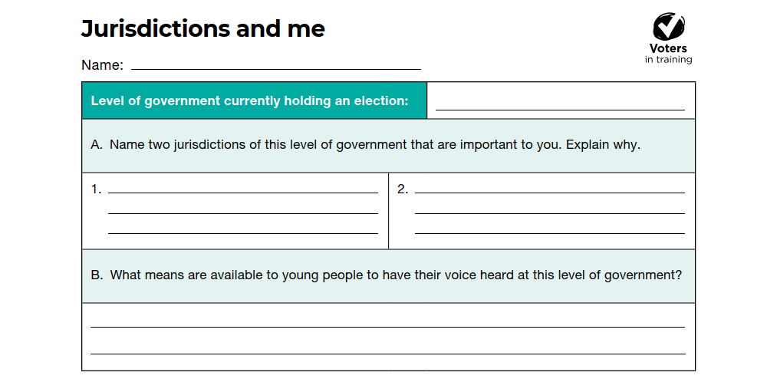
Notes:
Suggested animation
Hand out the Jurisdictions and me reflection sheet to the students.
Have them fill it out individually.
Collect the sheets at the end of the activity.

