Slide 1

Information sources under the microscope
Preparing to vote
Notes:
Suggested animation
Let the students know that in this activity, they will have to analyze the reliability of information sources they consult using a grid.
Additional information from the activity sheet Information sources under the microscope
In this activity, voters in training will exercise their critical thinking skills and analyze the reliability of various sources of information using a grid.
Objectives:
Analyze the reliability of information sources using a grid
Develop critical thinking skills

Slide 2
Where do you look for information on a topic that interests you?
Notes:
Suggested animation
Invite students to write down as many sources of information as they can on a note sheet or sticky note in one minute.
Start the timer.
When the time is up, bring the group back together to summarize the students’ responses and draw parallels with searching for information in an electoral context (candidates, elections, and current events).
If needed, supplement with the additional information in the “A bit of theory” section.
Variant: Invite students to come to the front of the class to post their sticky notes, grouping them by type of information.

Slide 3
What is the role of elected representatives during elections?
…
Notes:
Suggested animation
Ask the students the following question:
What is the role of elected representatives during elections?
Take a few responses.
(Expected answer: to make decisions for society as a whole)
Supplement the information as needed.
Explain to the students that even though they do not have the right to vote, they are about to take part in an electoral simulation with the actual candidates.
During an election campaign, to form your own opinion on the different candidates and make an informed choice when voting, it is essential to follow the debates and find out what the political parties and candidates are proposing.

Slide 4

Notes:
Suggested animation
Draw the students’ attention to the fact that regardless of where they look for information, they need to exercise caution, because a great deal of false or misleading information is circulating.
With the Internet and social media, false and misleading information spreads even more easily and can be read or heard quickly by large numbers of people.
-----------------------------------------------------------------------------------------------------------------------------
Image source:
Pixabay: Flat Design Symbol – Free vector images on Pixabay

Slide 5
DISINFORMATION
MISINFORMATION
With malicious intent
By mistake
Notes:
Suggested animation
This information comes from a variety of sources. It can be spread with malicious intent or by mistake.
We speak of disinformation when false information is spread deliberately, with malicious intent, in order to harm individuals or organizations.
For example, Sam spreads false information about certain candidates during the electoral simulation to mislead the other students and encourage them to vote for the candidate he prefers.
(CLICK)
We speak of misinformation when false information is spread by mistake, due to a lack of knowledge or because a person did not verify whether content was accurate before sharing it.
For example, Sam tells his friends that the electoral simulation will take place next Tuesday in the gym. Unfortunately, he mixed up the day with his basketball game, so his friends showed up at the gym for nothing.

Slide 6
Primary or secondary?
Primary information
Secondary information
Notes:
Suggested animation
Primary or secondary Information?
Here, we are not talking about your grade level; we are talking about the origin of an information source.
(CLICK)
Presentation of a primary source
An information source is primary if the information presented is direct or first-hand. The information must not have been analyzed or reformulated by another person. For example, the testimony of a scientist speaking about the results of research they conducted is a primary source.
(CLICK)
Presentation of a secondary source
An information source is secondary if the information presented is indirect. Information from another source is recounted, summarized, or analyzed. For example, a journalist who reports on the results of a university researcher’s study is a secondary source.
Point out to the students that news medium report facts, but also opinions.
• An analyst can shed light on current events;
• Editorialists can convey their medium outlet’s position on certain topics;
• A columnist can share their own point of view.

Slide 7
And what about Artificial Intelligence (AI)?
Notes:
Suggested animation
“AI is short for Artificial Intelligence.
“Artificial intelligence is a technology that imitates human intelligence. It allows computers to perform tasks such as learning, reasoning and decision-making.”
Source: Alloprof (n.d.). Artificial intelligence, consulted June 18, 2026. Artificial Intelligence - Elementary | Alloprof (https://www.alloprof.qc.ca/en/students/vl/sciences/artificial-intelligence-elementary-0-i0022p56)
Artificial intelligence is used in many fields and is playing an increasingly large role in our lives.
But is it a good idea to use artificial intelligence to find information? Not necessarily.
Even if the results obtained may seem convincing, artificial intelligence is often wrong.
If you use artificial intelligence to conduct research, it is best to exercise caution and always verify the generated responses against reliable sources.

Slide 8
If information is not always reliable, how can we form an opinion?
Notes:
Suggested animation
Ask the students the following question:
If information is not always reliable, how can we form an opinion?
Take a few responses.
Therefore, we cannot always trust what we read, hear, or see.
In order to make sense of all the sources of information we are exposed to and choose those that help us make informed choices, we need to exercise our critical thinking and conduct a little investigation.
To do this, we need clues, which we will find by asking ourselves three questions:
WHO is talking to me?
HOW are they talking to me?
WHY are they talking to me?

Slide 9
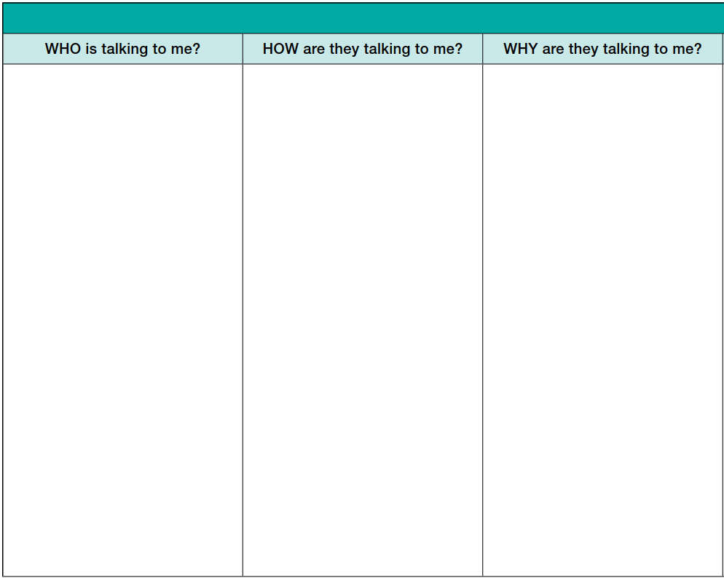
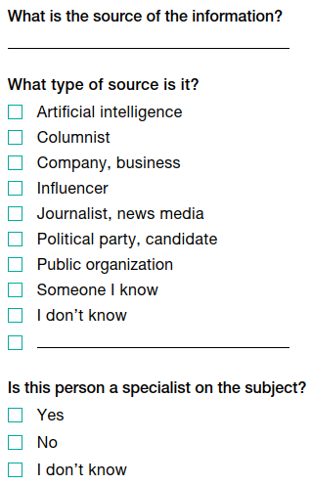
Notes:
Suggested animation
(CLICK)
The question WHO is talking to me?
Behind any piece of information, there is an author or a source.
This question asks us to identify which source is behind a piece of information and to determine whether we can trust it.
We must also ask ourselves what type of source it is and determine whether it is an expert on the subject.
There are different types of authors and sources.
Name the elements of the grid.
Additional information from the activity sheet Information sources under the microscope
There are different types of authors or sources.
Company, business
Columnist
Influencer
Artificial intelligence
Journalist, news media
Public organization (school, government, etc.) or community organization
Political party, candidate
People in our circle
Once we know what type of source of information we are dealing with, we need to assess whether that source knows the subject well enough for the information it shares to be credible. Here are some questions that can guide us:
Is the source a specialist in the field?
Does the information directly concern the source?
Is it an official website or a well-known media outlet?
On social media, is it an official account?
If we do not know the answer or if we answer no to these questions, we should be cautious, investigate further, or discard the source!

Slide 10
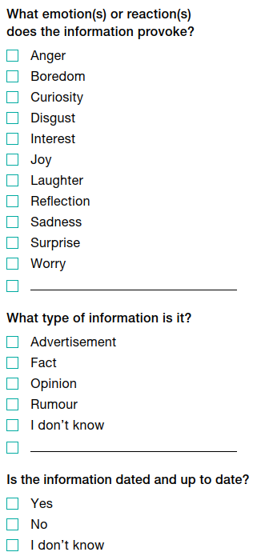
Notes:
Suggested animation
The question HOW are they talking to me?
The information we consult can generate different emotions and reactions.
This second question invites us to assess what emotions we feel about a piece of information.
Name the elements of the grid.
We must also look at the tone the author uses and the way they choose to present the information.
- For example, a very catchy headline that tries to make us react quickly is a way of appealing to our emotions, which can override reason and logic.
- News media tend to favour a neutral or informative tone. They have a duty to present verified information in their news story. Official sources, such as the government, also often use this tone.
This reflection gives us clues about the nature of the information: is it a fact? An opinion? A rumour? An advertisement?
In addition, the publication date of a piece of information, if mentioned, can also give us a telling clue.
Something that was true last year may no longer be true today.

Slide 11
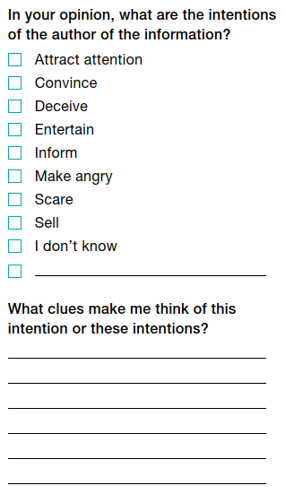
Notes:
Suggested animation
The question WHY are they talking to me?
Without necessarily being false, much of the information that reaches us is not there to inform us.
Trying to understand why someone is addressing us, and knowing their intentions, can help us decide whether or not to trust them.
Name the elements of the grid.
Point out to the students that the reasons are not always clearly stated. We often need to be shrewd in conducting our own investigation!
For example, we often easily recognize advertisements, but they can also be embedded—and even disguised—in the videos of content creators.
In a similar manner, political parties will publicly share their commitments during an election campaign. This is a way of informing electors about their plans… but also of trying to convince them to vote for them.
We must therefore look for clues in the information to identify those that point to the intention behind it.
Here is a grid for analyzing the reliability of an information source. This tool will be very useful when you conduct your investigation.

Slide 12
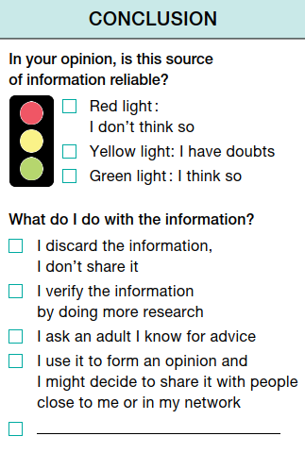
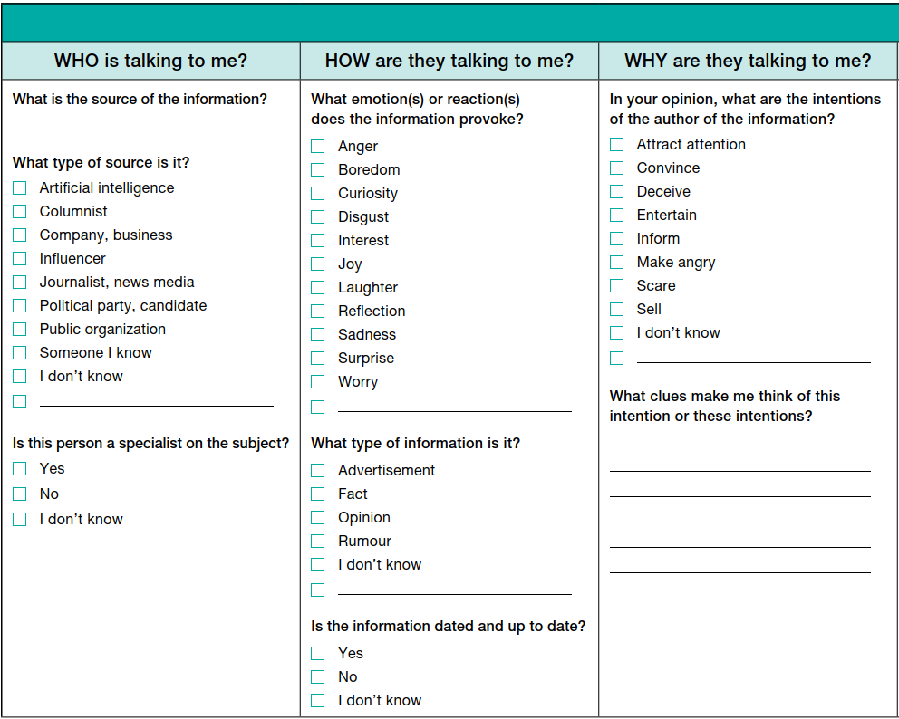
Notes:
Suggested animation
Present the conclusion to the students by explaining that, just like on the road, certain rules must be followed to navigate the world of information safely.
Imagine there is a traffic light in front of each new piece of information you come across.
If the light is red, you stop, because it is a source of information that is not reliable.
If the light is yellow, you slow down and verify, because you doubt that the source of information is reliable.
If the light is green, you go ahead, because you judge that the source of information is reliable.
It is only after conducting our investigation that we can decide what to do with the information.
Name the elements in the grid.

Slide 13

Intergalactique04
5 minutes ago
Scenario no. 1
During the election campaign, you see
a surprising post on social media
that catches your attention.
You do not know the person who posted this information, which portrays
the candidate in a negative light.
The post has been shared by thousands of people. You wonder whether this source of information is reliable.
Party R’s candidate says that all young people
are very lazy.
If elected, she will abolish summer vacation.
Don’t vote for her!!!
Notes:
Suggested animation
Model your thinking by completing the information reliability analysis exercise yourself using scenario no. 1.
Note: For the modelling to be effective, it is important to think aloud and express everything that comes to mind as you read through the scenario (reactions, emotions, ideas, and questions). It is also helpful to explain the connections you draw between the information presented and your line of thinking. These practices support the development of critical thinking in students.
To support you in this process, consult the activity sheet. You will find answer key related to scenario no. 1. Be authentic. The answer key is provided for guidance purposes only.
------------------------------------------------------------------------------------------------
Image source:
Smiley Emoji Graphic – Free vector images on Pixabay

Slide 14
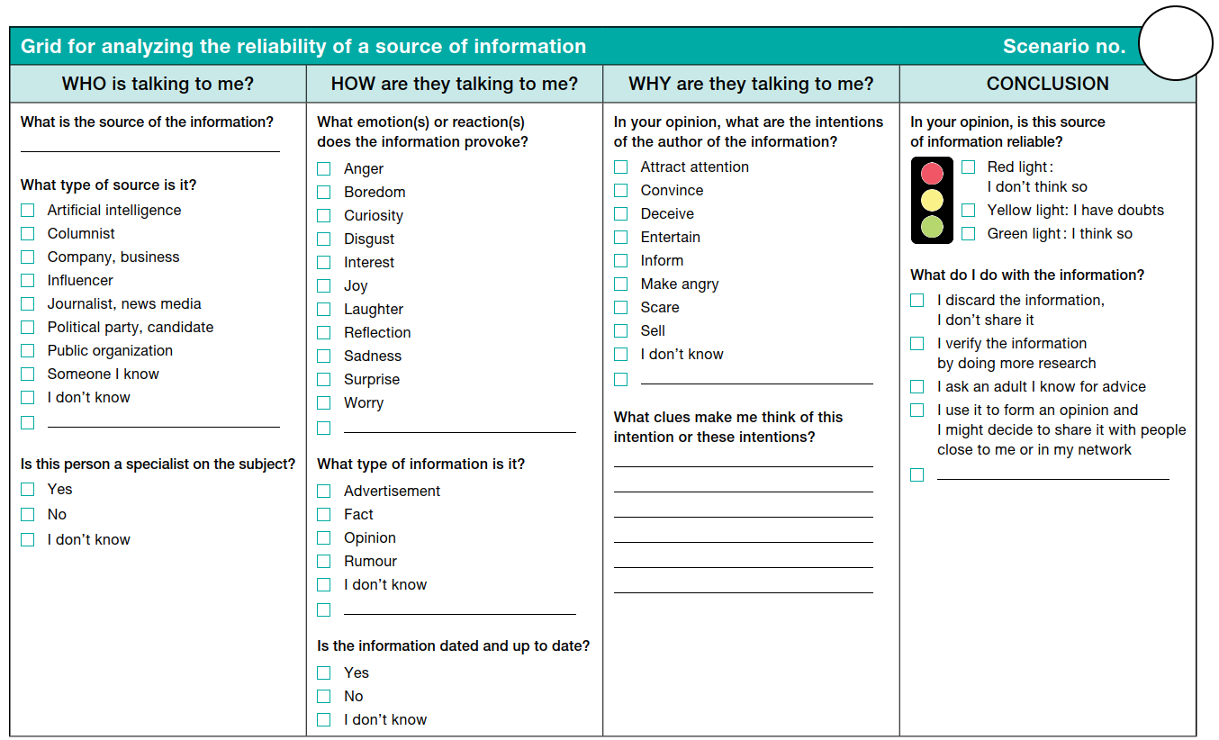
Example analysis for scenario no.1
1
Intergalactique04
X
X
X
X
X
Surprising and unlikely information
Portrays the candidate in a negative light and could provoke strong reactions
X
X
Could be a joke
Could be disinformation
X
Notes:
Suggested animation
Continue the modelling by transferring the comments made while reading scenario no. 1 into this grid.
Click the slide to reveal the answers as you express your thinking aloud.
For responses that can be interpreted in different ways, explain your thinking by taking into account emotions, reactions, and interpretation of intent.
Supplement the information as needed using the Answer key for the facilitator sheet.
I verify the information by doing further research to find out more about the person who published the information (biography, publication history).
I ask an adult in my circle for advice to see whether other reliable sources share the same information (the party’s or candidate’s website, news medium, etc.).
Another possible action: I discard the information, I don’t share it. Since I doubt the reliability of the source of information, I may also decide not to conduct further research and discard the information without sharing it, particularly because this information portrays the candidate in a negative light.

Slide 15
It's your turn!
Notes:
Suggested animation
Divide students into teams of three and invite them to designate a note keeper and a spokesperson.
Distribute to each team:
one copy of the Voters in Training activity sheet;
one copy of the Scenarios sheet per student.
Let the students know they will have five minutes to complete the analysis grid.
Choose the scenario you want the students to analyze.

Slide 16
Scenario no. 2
You follow influencer Y’s channel with interest—she is known for her fun videos
in which she shares all kinds of finds.
In today’s video, she shows a camera that can be purchased from her online shop. At the end of the video, the influencer shifts her focus to the elections and shares her point of view.
You wonder whether this source of information is reliable when it comes to elections.
None of the topics covered in the election campaign interest
young people
Y
It’s obvious—politics
is for old people!
Check out my latest find!!
23k views 2 hours ago … more
Y
@Y
928
Suscribed
13 k
Save
Comments 150
@soflavoie 1 hour ago Really?
Notes:
Suggested animation
Invite the teams to analyze scenario no. 2.
Start the timer for five minutes.
When the time is up, let the students know.

Slide 17
2
Influencer Y
X
Sale of a product
Current events and politics
are not among her usual topics
X
X
X
Notes:
Suggested animation
* Note: The completed answer key grids are provided for reference purposes to support the feedback on the activity with the students. Multiple answers are possible for the interpretive elements of the grid in relation to the scenarios. The goal is to allow students to exercise their critical thinking to analyze the reliability of a source of information.
Debrief the entire group.
Present the grid by naming the answers indicated on the sheet.
Select one team and ask its spokesperson to name the team’s emotions and reactions, the author’s intentions, as well as the team’s analysis conclusion — that is, the traffic light colour and the action(s) chosen.
Possible answers:
Emotions and reactions: various answers are possible depending on the students (e.g., surprise, sadness).
Intentions: various answers are possible depending on the students (e.g., attract attention, entertain, sell).
Conclusion (expected answers): red light; I discard the information, I do not share it.
Ask the other teams to indicate their own conclusion by raising their hand to show the traffic light colour they selected.
Depending on the time available for the activity, ask some teams to explain their answer.
Supplement the information as needed using the Answer key for the facilitator sheet.
I discard the information, I don’t share it The primary intention of the influencer is probably to sell their products, not to inform their audience. In addition, they are expressing an opinion, not a fact. To form an opinion, one would need to check whether the various parties and candidates address topics that affect students on their websites or social media. Some content is entertaining but is not necessarily a reliable source of information.

Slide 18


Scenario no. 3
Before the electoral simulation, you want to learn more about the candidates in the election. You use artificial intelligence to get a summary of their proposals.
The tool’s response mentions three candidates. However, you think you have seen election signs for more than three candidates on the street.
You wonder whether this source of information is reliable.
B
G
W
S
M
?
Party W
Party S
W
S
M
Party M
Parti J
Parti S
Parti W
Notes:
Suggested animation
Invite the teams to analyze scenario no. 3.
Start the timer for five minutes.
When the time is up, let the students know.
Image sources:
Robotics Robot Machine – Free vector images on Pixabay
Building Street Tree – Free vector images on Pixabay
Over 1,000 free vector images of Electric Pole Street and Signpost – Pixabay

Slide 19
3
Artificial intelligence
X
Technological tool
programmed to provide an answer
The intention is unknown
The accuracy of the answer
is not guaranteed
X
X
X
Notes:
Suggested animation
* Note: The completed answer key grids are provided for reference purposes to support the feedback on the activity with the students. Multiple answers are possible for the interpretive elements of the grid in relation to the scenarios. The goal is to allow students to exercise their critical thinking to analyze the reliability of a source of information.
Debrief the entire group.
Present the grid by naming the answers indicated on the sheet.
Select one team and ask its spokesperson to name the team’s emotions and reactions, the author’s intentions, as well as the team’s analysis conclusion — that is, the traffic light colour and the action(s) chosen.
Possible answers:
Emotions and reactions: various answers are possible depending on the students (e.g., curiosity, reflection, surprise).
Intentions: various answers are possible depending on the students (e.g., I don’t know).
Conclusion (expected answers): yellow light; I verify the information by doing further research and/or I ask an adult in my circle for advice.
Ask the other teams to indicate their own conclusion by raising their hand to show the traffic light colour they selected.
Depending on the time available for the activity, ask some teams to explain their answer.
Supplement the information as needed using the Answer key for the facilitator sheet.
I verify the information by doing further research or I ask an adult in my circle for advice. Artificial intelligence is not a reliable source of information. If you use it, you should exercise caution and always verify the generated answers against reliable sources.
Another possible action: I discard the information, I don’t share it. Since I doubt the reliability of the source of information, I may also decide not to conduct further research and discard the information without sharing it.

Slide 20

Guess what?
The hockey team’s mascot
is going to run in the election!
Scenario no. 4
Your friend proudly announces what he heard on the radio: the hockey team’s mascot will be running in the election!
The message draws attention and creates a strong reaction.
For your part, you wonder whether this source of information is reliable.
Voting for a mascot is going to be funny!
This is too funny, I’m going to tell everyone!
I thought only real people could run in elections!
Notes:
Suggested animation
Invite the teams to analyze scenario no. 4.
Start the timer for five minutes.
When the time is up, let the students know.
Image source:
Skateboard Helmet – Free vector images on Pixabay
Tux Linux Vector – Free vector images on Pixabay
Hockey Stick Goalie Goal – Free vector images on Pixabay

Slide 21
4
My friend
X
Very surprising information
The information provokes reactions (e.g., laughter, questioning, desire to share
the information)
X
X
X
Notes:
Suggested animation
* Note: The completed answer key grids are provided for reference purposes to support the feedback on the activity with the students. Multiple answers are possible for the interpretive elements of the grid in relation to the scenarios. The goal is to allow students to exercise their critical thinking to analyze the reliability of a source of information.
Debrief the entire group.
Present the grid by naming the answers indicated on the sheet.
Select one team and ask its spokesperson to name the team’s emotions and reactions, the author’s intentions, as well as the team’s analysis conclusion — that is, the traffic light colour and the action(s) chosen.
Possible answers:
Emotions and reactions: various answers are possible depending on the students (e.g., reflection, laughter, surprise).
Intentions: various answers are possible depending on the students (e.g., attract attention, entertain).
Conclusion (expected answers): yellow light; I verify the information by doing further research and/or I ask an adult in my circle for advice.
Ask the other teams to indicate their own conclusion by raising their hand to show the traffic light colour they selected.
Depending on the time available for the activity, ask some teams to explain their answer.
Supplement the information as needed using the Answer key for the facilitator sheet.
I verify the information by doing further research or I ask an adult in my circle for advice. This friend may not be a reliable source. They are repeating information they say they heard on the radio, but there is no way of knowing whether this information is accurate.
Another possible action: I discard the information, I don’t share it. Since I doubt the reliability of the source of information, I may also decide not to conduct further research and discard the information without sharing it.

Slide 22
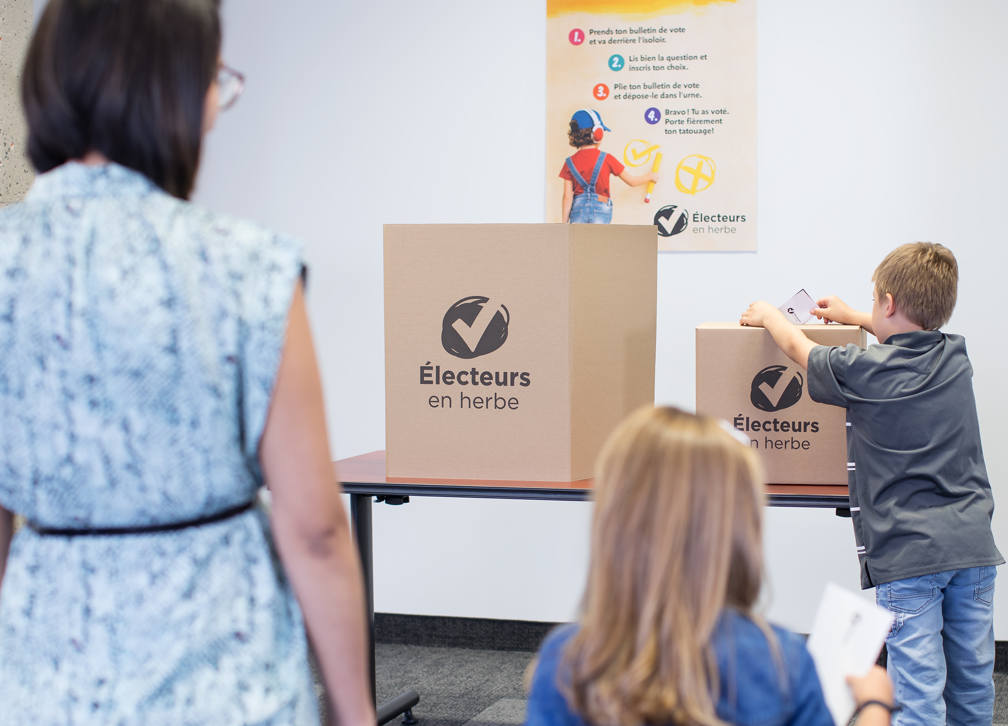
Élections Québec’s small polling stations
Scenario no. 5
In today’s local newspaper,
you read this article.
It is an interview with the Élections Québec spokesperson conducted
by a journalist.
You wonder whether you can share this information.
“This activity is organized to teach young people how to vote and to let them experience democracy as a family.
Children answer a question designed especially
for them.”
(Élections Québec spokesperson)
Sora Maran
Young people can vote at the same time as adults.
Image source: Élections Québec
Notes:
Suggested animation
Invite the teams to analyze scenario no. 5.
Start the timer for five minutes.
When the time is up, let the students know.

Slide 23
5
Local newspaper
X
X
Information from a
well-known newspaper’s
article
Information dated today
X
For the Élections Québec spokesperson
X
The journalist cites a source who is a specialist on the
subject
X
Notes:
Suggested animation
* Note: The completed answer key grids are provided for reference purposes to support the feedback on the activity with the students. Multiple answers are possible for the interpretive elements of the grid in relation to the scenarios. The goal is to allow students to exercise their critical thinking to analyze the reliability of a source of information.
Debrief the entire group.
Present the grid by naming the answers indicated on the sheet.
Select one team and ask its spokesperson to name the team’s emotions and reactions, the author’s intentions, as well as the team’s analysis conclusion — that is, the traffic light colour and the action(s) chosen.
Possible answers:
Emotions and reactions: various answers are possible depending on the students (e.g., curiosity, interest, joy, surprise).
Intentions: various answers are possible depending on the students (e.g., inform).
Conclusion (expected answers): green light; I use the information to form an opinion and I might decide to share it with people close to me or in my network.
Ask the other teams to indicate their own conclusion by raising their hand to show the traffic light colour they selected.
Depending on the time available for the activity, ask some teams to explain their answer.
Supplement the information as needed using the Answer key for the facilitator sheet.
I use the information to form an opinion and I might decide to share it with people close to me or in my network. The source of information in this scenario is a newspaper article (secondary source), in which the journalist cites the Élections Québec spokesperson (primary source). Journalists have a responsibility to verify the information they publish.

Slide 24
Name one thing you learned in this activity.
?
Notes:
Suggested animation
Invite the voters in training to share what they learned through this activity.
Tell them they can use the analysis grid in any context where they are searching for information.

